Slide 1

Dept. of Computer Science and Engineering BRAC University CSE 341 Team
8086 Addressing Modes

Slide 2
Lecture References:
Book:
Microprocessors and Interfacing: Programming and Hardware, Chapter # 2, Author: Douglas V. Hall
The 8086/8088 Family: Design, Programming, And Interfacing, Chapter # 2, Author: John Uffenbeck.

Slide 3
Addressing Mode and Categories
The different ways in which a microprocessor can access data are referred to as its addressing modes.
Addressing modes of 8086 Microprocessor are categorized as:
Addressing Data
Addressing Program codes in memory
Addressing Stack in memory
Addressing I/O
Implied addressing

Slide 4
Things to know…
Instruction format
Instructions can have 1, 2 or no operands
INC AX ; 1 operand
ADD CX, DX ; 2 operands CX = CX + DX
HLT ; no operand
Instruction cannot have:
SUB [DI], [1234h] ; memory locations as both operands
MOV 1234, AX ; immediate data as destination operand
opcode
Operand(s)
Destination source

Slide 5
1. Addressing Data
Immediate addressing
Direct addressing
Register [direct] addressing
Register indirect addressing
Base-plus-index addressing
Register relative addressing
Base-relative-plus-index addressing

Slide 6
1. Addressing Data
Immediate addressing
Data is immediately given in the instruction
MOV BL, 11
Direct addressing
Data address is directly given in the instruction
MOV BX, [437AH]
b
d
h

Slide 7
1. Addressing Data
Register [direct] addressing
Data is in a register (here BX register contains the data)
MOV AX, BX
Register [indirect] addressing
Register supplies the address of the required data
MOV CX, [BX]
MOV AL, BX

Slide 8
1. Addressing Data
Base-plus-index addressing
Base register is either BX or BP
Index register is either DI or SI
MOV DX, [BX+DI]
Register relative addressing
Register can be a base (BX, BP) or an index register (DI, SI)
Mainly suitable to address array data
MOV AX, [BX+1000]

Slide 9
1. Addressing Data
Base-relative-plus-index addressing
Suitable for array addressing
MOV AX, [BX+DI+10]

Slide 10
2. Addressing Program Codes in Memory
Used with JMP and CALL instructions
3 distinct forms:
Direct
Indirect
Relative

Slide 11
2. Addressing Program Codes in Memory
Address is directly given in the instruction
JMP 1000: 0000
JMP doagain ; doagain is a label in code
CALL 1000:0000
CALL doagain ; doagain is a procedure in code
Often known as far jump or far call
CS IP

Slide 12
2. Addressing Program Codes in Memory
Address can be obtained from
a) any GP registers (AX,BX,CX,DX,SP,BP,DI,SI)
JMP AX
b) any relative registers ([BP],[BX],[DI],[SI])
JMP [BX]
c) any relative register with displacement JMP [BX + 100h]
IP = AX ; then CS : IP
IP = what is inside the physical address of DS : BX ; then CS : IP
IP = what is inside the physical address of DS : BX +100h ; then CS : IP

Slide 13
3. Addressing Stack in Memory
PUSH and POP instructions are used to move data to and from stack (in particular from stack segment).
PUSH AX
POP CX
CALL also uses the stack to hold the return address for procedure.
CALL SUM ; SUM is a procedure name

Slide 14
4. Addressing Input and Output Port
IN and OUT instructions are used to address I/O ports
Could be direct addressing
IN AL, 05h ; Here 05h is a input port number
or indirect addressing
OUT DX, AL ; DX contains the address of I/O port
Only DX register can be used to point a I/O port

Slide 15
5. Implied Addressing
No explicit address is given with the instruction
implied within the instruction itself
Examples:
CLC ; clear carry flag
HLT ; halts the program
RET ; return to DOS

Slide 16
Dept. of Computer Science and Engineering BRAC University CSE 341 Team
8086 Machine Codes

Slide 17
Instruction template
For 8085: Just look up the hex code for each instruction.
For 8086 it is not simple.
E.g 32 ways to specify the source in MOV CX, source.
MOV CX, source
Each of these 32 instructions require different binary code.
Impractical to list them all in a table.
Instruction templates help code the instruction properly.
a 16-bit register (8 in number)
a memory location (24 possible memory addressing modes)

Slide 18
Instruction template (6 bytes)
BYTE 1
BYTE 2
OPCODE |  |  |  |  |  | D | W | MOD |  | REG |  |  | R/M
BYTE 3
BYTE 4
LOW BYTE DISPLACEMENT / DATA |  |  |  |  |  |  |  | HIGH BYTE DISPLACEMENT / DATA
BYTE 5
BYTE 6
LOW BYTE of IMMEDIATE DATA |  |  |  |  |  |  |  | HIGH BYTE of IMMEDIATE DATA
An instruction after conversion can have 1 to 6 bytes long of machine code

Slide 19
Constructing Machine Codes for 8086
Each instruction in 8086 is associated with the binary code.
You need to locate the codes appropriately.
Most of the time this work will be done by assembler
The things needed to keep in mind is:
Instruction templates and coding formats
MOD and R/M Bit patterns for particular instruction

Slide 20

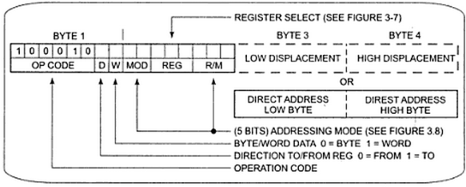
MOV Instruction Coding
MOV data from a register to a register/to a memory location or from a memory location to a register. (Operation Code of MOV: 100010)

Slide 21
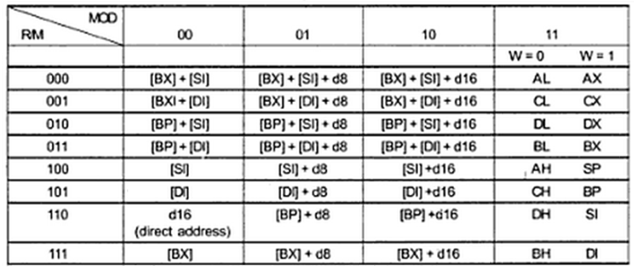
MOD and R/M Field
2-bit Mode (MOD) and 3-bit Register/Memory (R/M) fields specify the other operand.
Also specify the addressing mode.

Slide 22
MOD and R/M Field
If the other operand in the instruction is also one of the eight register then put in 11 for MOD bits in the instruction code.
If the other operand is memory location, there are 24 ways of specifying how the execution unit should compute the effective address of the operand in the main memory.
If the effective address specified in the instruction contains displacement less than 256 along with the reference to the contents of the register then put in 01 as the MOD bits.
If the expression for the effective address contains a displacement which is too large to fit in 8 bits then out in 10 in MOD bits.

Slide 23
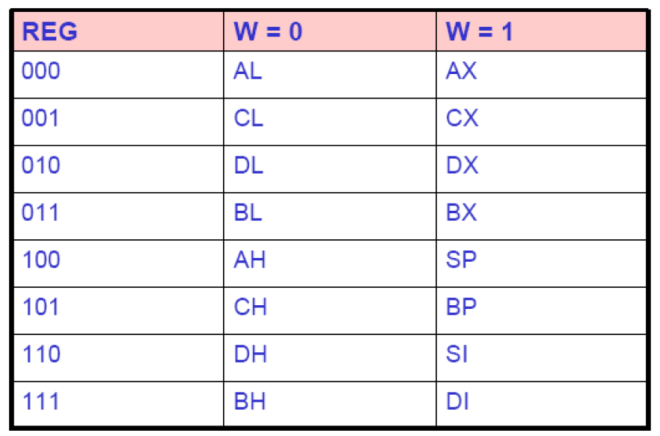
REG Field
REG field is used to identify the register of the one operand

Slide 24
Instruction template
BYTE 1
BYTE 2
6 bits of
MOV, ADD etc
OPCODE |  |  |  |  |  | D | W | MOD |  | REG |  |  | R/M
D - direction If D=0, then direction is from a register (source) If D=1, then direction is to a register (destination)
W - word If W=0, then only a byte is being transferred (8 bits)
If W=1, them a whole word is being transferred (16 bits)
MODE | OPERAND NATURE
00 | Memory with no displacement
01 | Memory with 8-bit displacement
10 | Memory with 16-bit displacement
11 | Both are registers
34h here is an 8-bit displacement
[BX+34h] is a memory/offset address
MOV AX, [BX]
MOV AX, [BX + 12h]
MOV AX, [BX + 1234h]
MOV AX, BX
MOV [BX + 34h ], AL
MOV AX, 1234 h
1234h here is a 16-bit immediate data value

Slide 25
Instruction template
BYTE 1
BYTE 2
OPCODE |  |  |  |  |  | D | W | MOD |  | REG |  |  | R/M
Value for R/M with corresponding MOD value
Value for REG with corresponding W value and the register considered in D
Check column that matches with MOD value

Slide 26
Example 1
MOV 8B43H [SI], DH: Copy a byte from DH to memory with 16 bit displacement given the opcode for MOV=100010
BYTE 1
BYTE 2
0
0
1 0
1 | 0 | 0 | 0 | 1 | 0
OPCODE |  |  |  |  |  | D | W | MOD |  | REG |  |  | R/M
Therefore D=0
source
-- 8 bits (not a word size)
MODE | OPERAND NATURE
00 | Memory with no displacement
01 | Memory with 8-bit displacement
10 | Memory with 16-bit displacement
11 | Both are registers
MOV [SI + 8B43H] , DH
Therefore W=0
BYTE 3
BYTE 4
LOW BYTE DISPLACEMENT / DATA |  |  |  |  |  |  |  | HIGH BYTE DISPLACEMENT / DATA

Slide 27
Example 1
MOV 8B43H [SI], DH: Copy a byte from DH to memory with 16 bit displacement given the opcode for MOV=100010
BYTE 1
BYTE 2
0
0
1 0
1 | 0 | 0 | 0 | 1 | 0
OPCODE |  |  |  |  |  | D | W | MOD |  | REG |  |  | R/M
1 | 1 | 0
MOV [SI + 8B43H] , DH

Slide 28
Example 1
MOV 8B43H [SI], DH: Copy a byte from DH to memory with 16 bit displacement given the opcode for MOV=100010
BYTE 1
BYTE 2
0
0
1 0
1 | 0 | 0 | 0 | 1 | 0
OPCODE |  |  |  |  |  | D | W | MOD |  | REG |  |  | R/M
1 | 1 | 0
1 | 0 | 0
MOV [SI + 8B43H] , DH

Slide 29
Example 1
MOV 8B43H [SI], DH: Copy a byte from DH to memory with 16 bit displacement given the opcode for MOV=100010
BYTE 1
BYTE 2
0
0
1 0
1 | 0 | 0 | 0 | 1 | 0
OPCODE |  |  |  |  |  | D | W | MOD |  | REG |  |  | R/M
1 | 1 | 0
1 | 0 | 0
MOV [SI + 8B43H] , DH
BYTE 3
BYTE 4
1 1
1 1
LOW BYTE DISPLACEMENT |  |  |  |  |  |  |  | HIGH BYTE DISPLACEMENT
0 | 1 | 0 | 0 | 0 | 0
1 | 0 | 0 | 0 | 1 | 0
Machine Code: 1000 1000 1011 0100 0100 0011 1000 10112 or 88 B4 43 8B16

Slide 30
Example 2
MOV AX, BX: given the opcode for MOV=100010
BYTE 1
BYTE 2
1
1
1 1
1 | 0 | 0 | 0 | 1 | 0
OPCODE |  |  |  |  |  | D | W | MOD |  | REG |  |  | R/M
AX considered which is a destination operand,
therefore D = 0
destination
-- 16 bits (a word size)
MODE | OPERAND NATURE
00 | Memory with no displacement
01 | Memory with 8-bit displacement
10 | Memory with 16-bit displacement
11 | Both are registers
AX is 16-bit long,
therefore W = 1
MOV AX, BX

Slide 31
Example 2
MOV AX, BX: given the opcode for MOV=100010
BYTE 1
BYTE 2
1
1
1 1
1 | 0 | 0 | 0 | 1 | 0
OPCODE |  |  |  |  |  | D | W | MOD |  | REG |  |  | R/M
0 | 0 | 0

Slide 32
Example 2
Machine Code: 1000 1011 1100 00112 or 8B C316
MOV AX, BX: given the opcode for MOV=100010
BYTE 1
BYTE 2
1
1
1 1
1 | 0 | 0 | 0 | 1 | 0
OPCODE |  |  |  |  |  | D | W | MOD |  | REG |  |  | R/M
0 | 0 | 0
0 | 1 | 1

Slide 33
QUIZ
Compute the machine code for the following using the table below and the opcode for MOV as100010
a) MOV AX, 5E9Ch b) MOV DH, [BP+SI+7Dh]

Slide 34
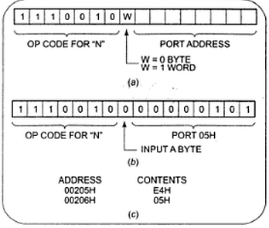
Instruction Template
The Intel literature shows two different formats for coding 8086 instructions.
Instruction templates helps you to code the instruction properly.
Example:
IN AL, 05H

Slide 35
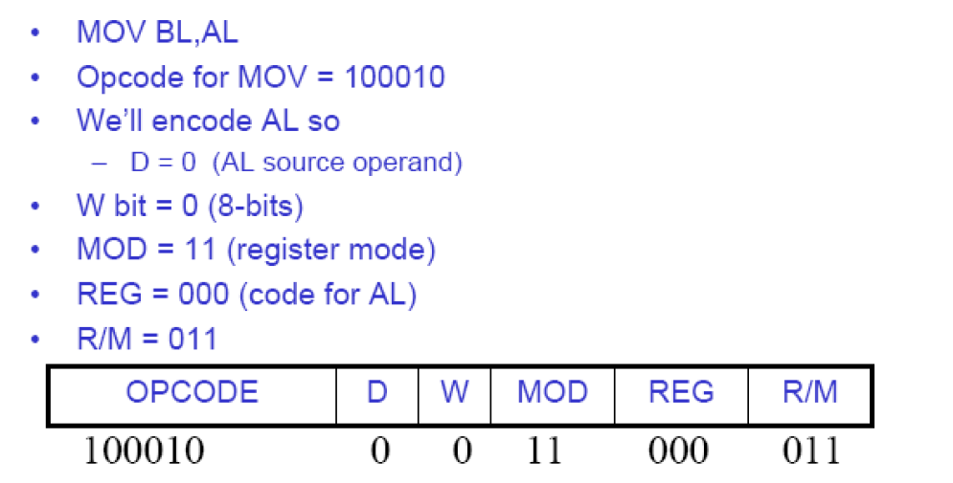
Example

Slide 36
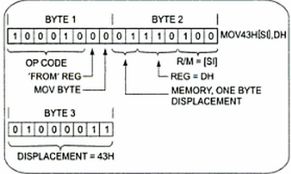
Example
MOV 43H [SI], DH: Copy a byte from DH register to memory location.

Slide 37
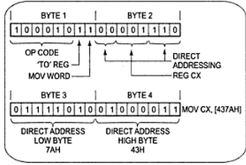
Example 3
MOV CX, [437AH]: Copy the contents of the two memory locations to the register CX.

Slide 38
QUIZ
Compute the machine code for the following using the table below and the opcode for MOV as100010
a) MOV AX, 5E9Ch b) MOV DH, [BP+SI+7Dh]

Slide 39
Thank You !!!

